Slide 1
Introduction to Statistical Methods
ISM Team

Slide 2

IMP Note to Self

Slide 3
RECAPITULATION:
Addition Rule of Probability
Conditional Probability
Independent events
Total Probability

Slide 4
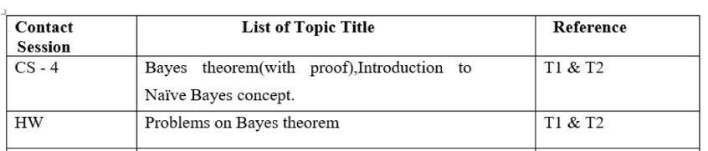
Baye’s theorem and Naïve Bayes theorem
(Session 4: 14th&15th December 2024)

Slide 5
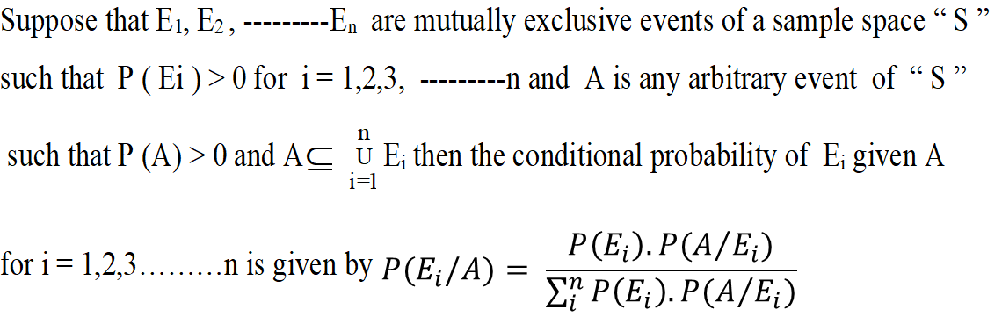





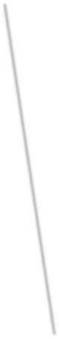
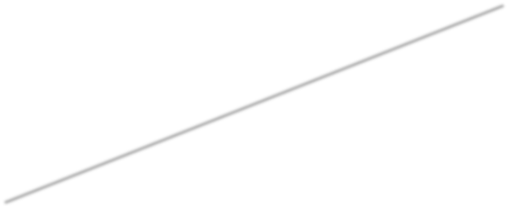
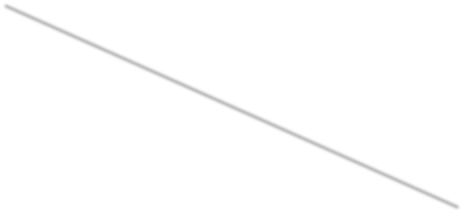
BAYE’S THEOREM:

Slide 6
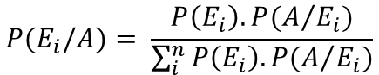
$$P(E_{i}/A)= \frac{P\left(E_{i}\right).P(A/{E_{i}})}{\sum_{i}^{n}{P\left(E_{i}\right).P(A/{E_{i}})}}$$

Slide 7
$$P(E_{i}/A)= \frac{P\left(E_{i}\right).P(A/{E_{i}})}{\sum_{i}^{n}{P\left(E_{i}\right).P(A/{E_{i}})}}$$

Slide 8
$$P(E_{i}/A)= \frac{P\left(E_{i}\right).P(A/{E_{i}})}{\sum_{i}^{n}{P\left(E_{i}\right).P(A/{E_{i}})}}$$

Slide 9
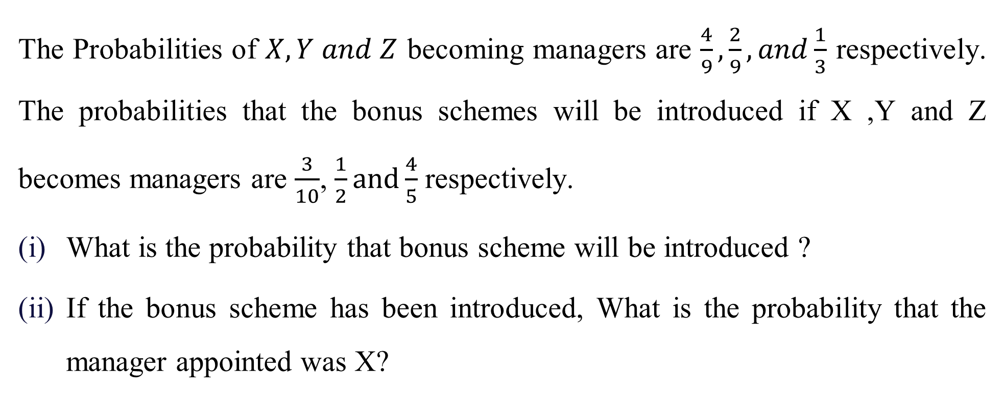
Example:1

Slide 10
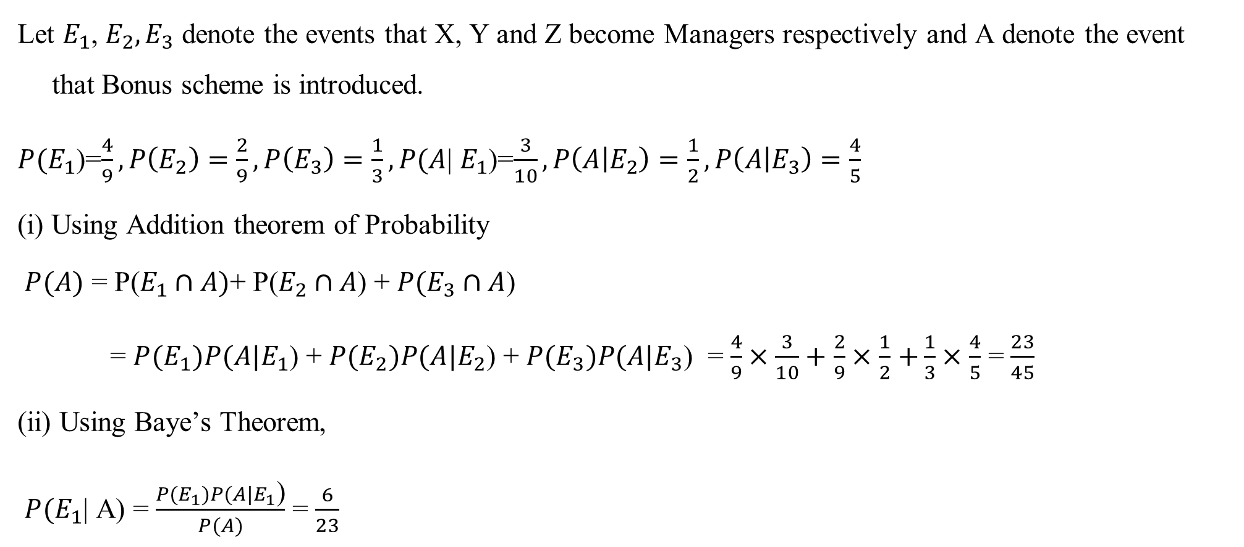
Solution:
$$P(E_{i}/A)= \frac{P\left(E_{i}\right).P(A/{E_{i}})}{\sum_{i}^{n}{P\left(E_{i}\right).P(A/{E_{i}})}}$$

Slide 11
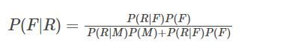
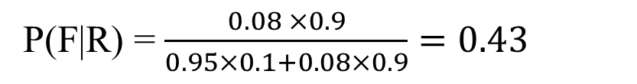
Example: 2
$$P(E_{i}/A)= \frac{P\left(E_{i}\right).P(A/{E_{i}})}{\sum_{i}^{n}{P\left(E_{i}\right).P(A/{E_{i}})}}$$
In a neighborhood, 90% children were falling sick due to flu and 10% due to measles
and no other disease. The probability of observing rashes for measles is 0.95 and for flu
is 0.08. If a child develops rashes, Find the child’s probability of having flu.
Solution:
Let, F: children with flu M: children with measles
R: children showing the symptom of rash
P(F) = 90% = 0.9, P(M) = 10% = 0.1
P(R|F) = 0.08, P(R|M) = 0.95

Slide 12
Example:3
It is estimated that 50% of emails are spam emails. Some software has been applied to filter these spam emails before they reach your inbox. A certain brand of software claims that it can detect 99% of spam e-mails, and the probability for a false positive (a non-spam email detected as spam) is 5%.Now if an email is detected as spam, then what is the probability that it is in fact a non-spam email?

Slide 13
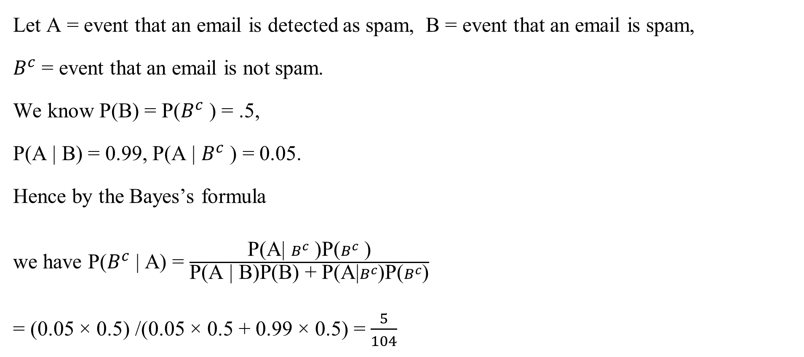
Solution:
$$P(E_{i}/A)= \frac{P\left(E_{i}\right).P(A/{E_{i}})}{\sum_{i}^{n}{P\left(E_{i}\right).P(A/{E_{i}})}}$$

Slide 14
Example :
Weather | Play
Sunny | No
Overcast | Yes
Rainy | Yes
Sunny | Yes
Sunny | Yes
Overcast | Yes
Rainy | No
Rainy | No
Sunny | Yes
Rainy | Yes
Sunny | No
Overcast | Yes
Overcast | Yes
Rainy | No
If the weather is sunny, Then the player will play or not?
i.e., Play /sunny = Yes or No.
Note: If we know P(Yes/Sunny) and P(No/Sunny)
then we can answer the question asked

Slide 15
Steps to Apply Bayes Theorem
Step1: View or Collect “raw” data
Step2: Convert long data into frequency table
Step3: Row and Column sums to get Probabilities
Weather Probabilities: Sunny =5/14,Rainy=5/14,Overcast= 4/14
Play Probabilities :
No =5/14
Yes =9/14
Weather | No | Yes
Sunny | 2 | 3
Overcast | 0 | 4
Rainy | 3 | 2

Slide 16
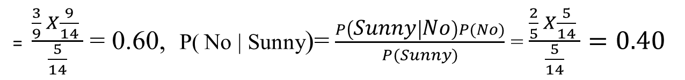
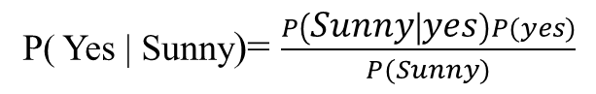
Weather
No
Yes
Weather | No | Yes | Row Total
Sunny | 2 | 3 | 5 | P(sunny)= 5/14
Overcast | 0 | 4 | 4 | P(overcast)=4/14
Rainy | 3 | 2 | 5 | P(Rainy)= 5/14
Column Total | 5 | 9 | 14
 | P(no)=5/14 | P(yes)=9/14
Step4: Apply Probabilities from frequency table to Bayes Theorem
P( Yes | Sunny) > P( No | Sunny) . Hence, The Player will play the game.

